Slide 1
Group 5
Mohammed Asik 093947
Raavi Vinay Kumar 093992
Madhuri Sanapala 093963
Rohit Hurkadli 094048
Bindu Shree 093941

Slide 2
FUNDAMENTALS
OF
HARDWARE

Slide 3
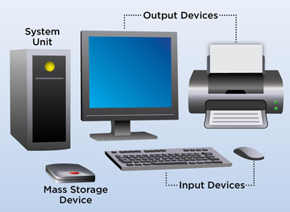
What is Computer?
A computer is a programmable electronic device designed to accept data, perform prescribed mathematical and logical operations at high speed, and display the results of these operations, all under the control of software.

Slide 4
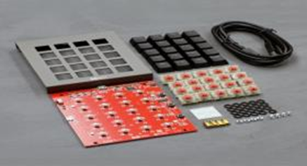
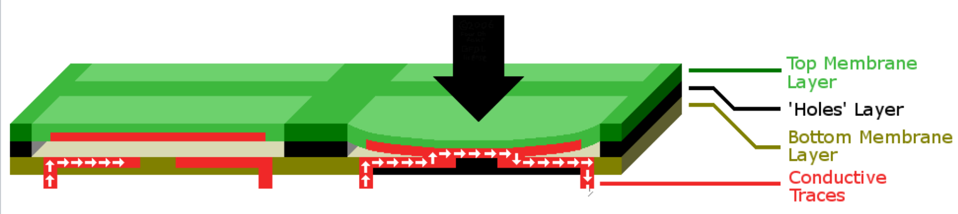
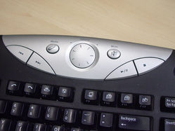
Keyboard
Mechanical Keyboard
Membrane Keyboard
Multimedia Keyboard

Slide 5
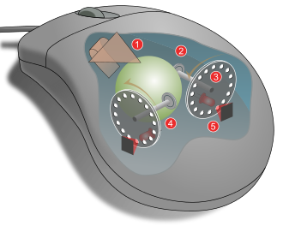
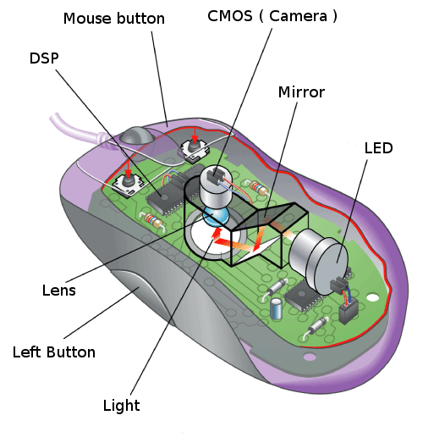
Mouse
Mechanical Mouse
Optical Mouse

Slide 6
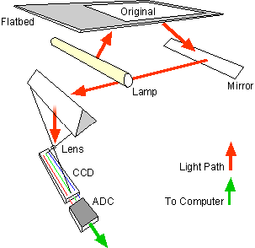
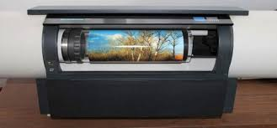

Scanner
Flatbed Scanner
Drum Scanner
Handheld Scanner

Slide 7
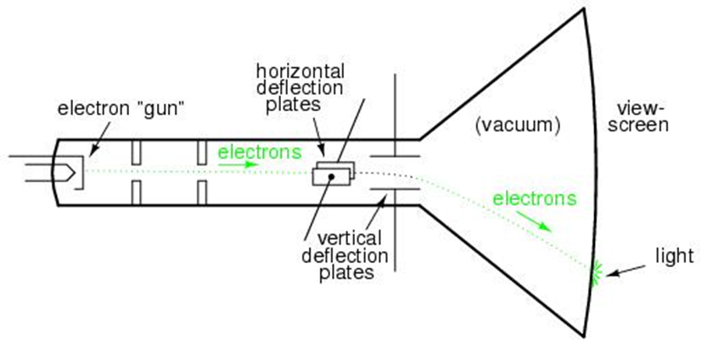
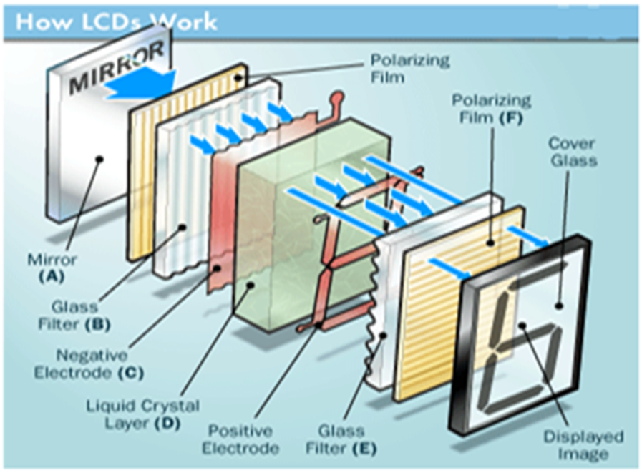
Monitor
CRT Monitor
LCD Monitor

Slide 8
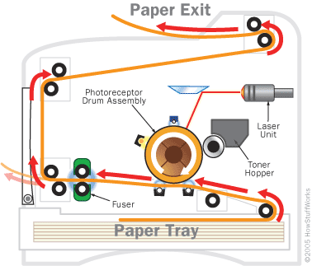
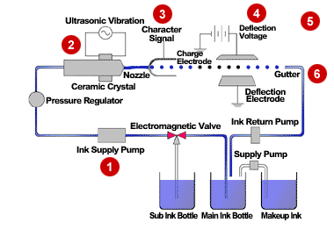
Printer
Laser Printer
Inkjet Printer

Slide 9
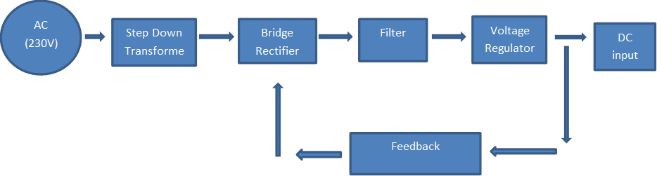
SMPS
Working Principle
Notes:
A cor AZUL sempre tem que aparecer no slide. Seja nas formas ou no texto.
Uma imagem como essa nao funciona. Muito “Barbie” para uma consultoria. Eles gostam deste layout mas deveria estar separador de capitulos com o logo de “espadas” maior. Para toda insercao de imagem o fundo deve ser cinza claro.

Slide 10
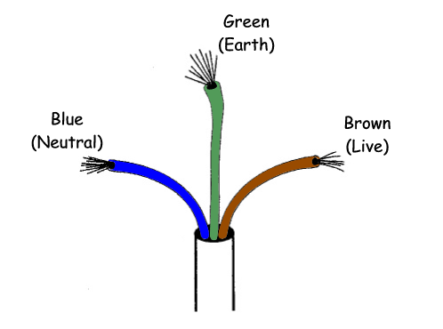
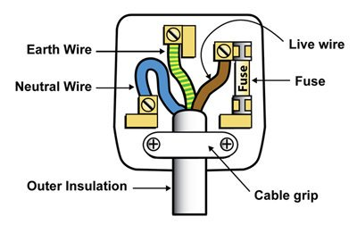
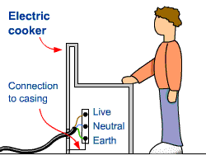
Earthing
Notes:
A cor AZUL sempre tem que aparecer no slide. Seja nas formas ou no texto.
Uma imagem como essa nao funciona. Muito “Barbie” para uma consultoria. Eles gostam deste layout mas deveria estar separador de capitulos com o logo de “espadas” maior. Para toda insercao de imagem o fundo deve ser cinza claro.

Slide 11
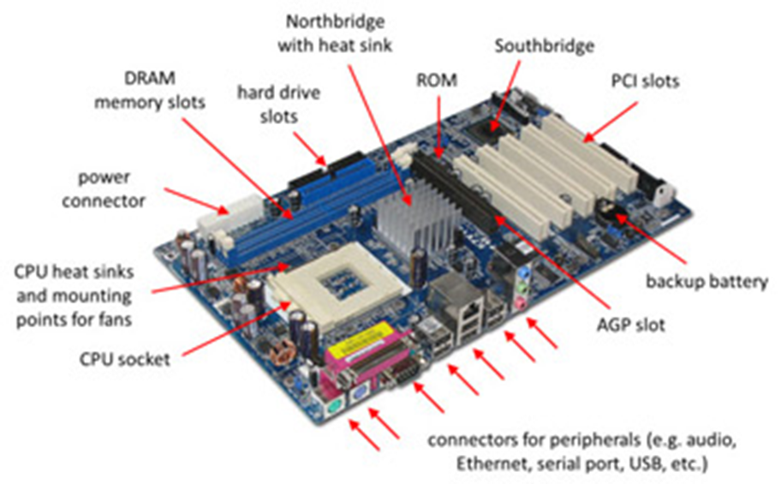
Motherboard
A motherboard is the main circuit
board inside a computer that connects
the different parts of a computer
together directly or indirectly.
Types of Motherboard :
ATX motherboard
Full AT motherboard
Baby AT motherboard

Slide 12
Connectors:
PCI SLOT (Peripheral Component Interconnect) : PCI slots are used to Insert or install Add-on cards, such as LAN cards, Sound cards, Capture cards and TV tuner cards. There are usually anywhere from 1 to 6 PCI slots available on the motherboard(above board has 2 PCI slots. ), they have decreased in number and are being replaced by the PCI Express 1x slots.
Northbridge: This allows communication between the CPU and the system memory and PCI-E slots.
Southbridge: This is the controller for components such as the PCI slots, onboard audio, and USB connections.
SATA Connections : SATA full form is Serial Advanced Technology Attachment. These are connected with serial ATA devices, such as Hard disk drives and CD or DVD drives.
ATX Power Connector: This is the second of two power connections. This is the main power connection for the motherboard, and comes from the Power Supply.
DIMM slots: DIMM's are by far and away the most used memory types in today's computers. They vary in speeds and standards however and they need to match up to what your motherboard has been designed to take. The four standards of DIMM's being used at the moment are SDR (Single Data Rate), DDR (Double Data Rate), DDR2 and DDR3. The speeds of memory can vary between 66Mhz to 1600Mhz .

Slide 13
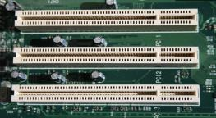
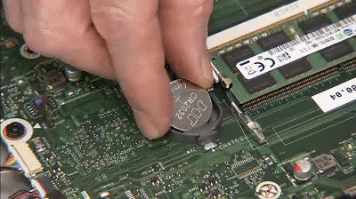
ISA (Industry Standard Architecture:(16 bit)
It allows 16 bits data at the time to flow between the Motherboard
circuitry and expansion slot card
EISA ( Extended Industry Standard Architecture-32bit)
CNR:
Communications and network Riser is used for networking, audio and telephone equipment. It has two rows of 30 pins.
CMOS battery:
“Complimentary metal-oxide semiconductor”. It is an onboard, battery powered semiconductor chip inside computers that stores Bios settings.

Slide 14
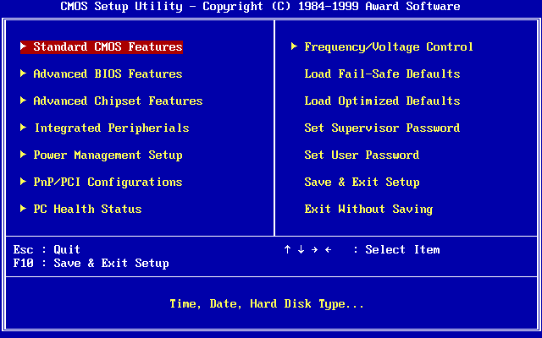
BIOS
1. Check the CMOS Setup for custom settings.
2. Load the interrupt handlers and device drivers.
3. Initialize registers and power management.
4. Perform the power-on self-test (POST).
5. Display system settings.
6. Determine which devices are bootable.
7.Initiate the bootstrap sequence.

Slide 15
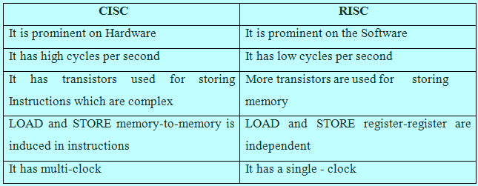
Architecture of CPU

Slide 16
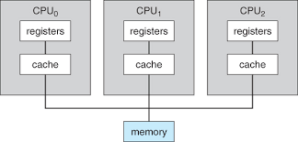
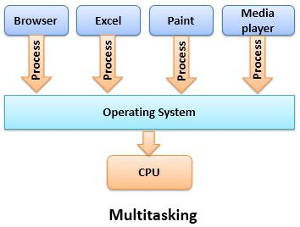
Multiprocessing

Slide 17
Memory
Primary Memory
Secondary Memory
Cache Memory
L1
L2
L3
RAM
ROM
Magnetic storage
Optical storage
SRAM
DRAM
PROM
EPROM
EEPROM
Hard disk
Magnetic tapes
CD
DVD

Slide 18
FUNDAMENTALS
OF
WINDOWS

Slide 19
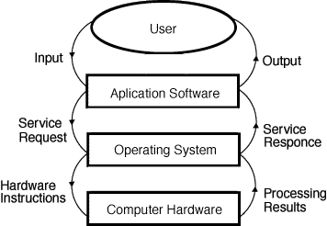
Operating System

Slide 20
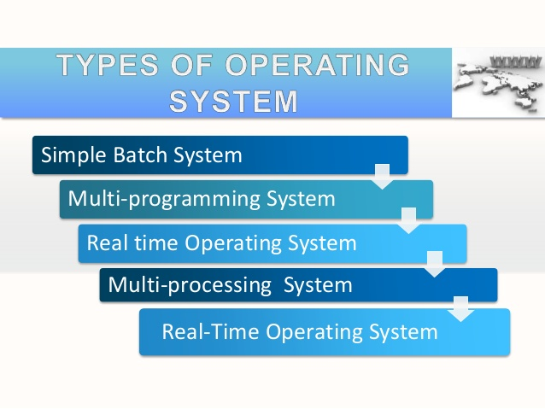

Slide 21
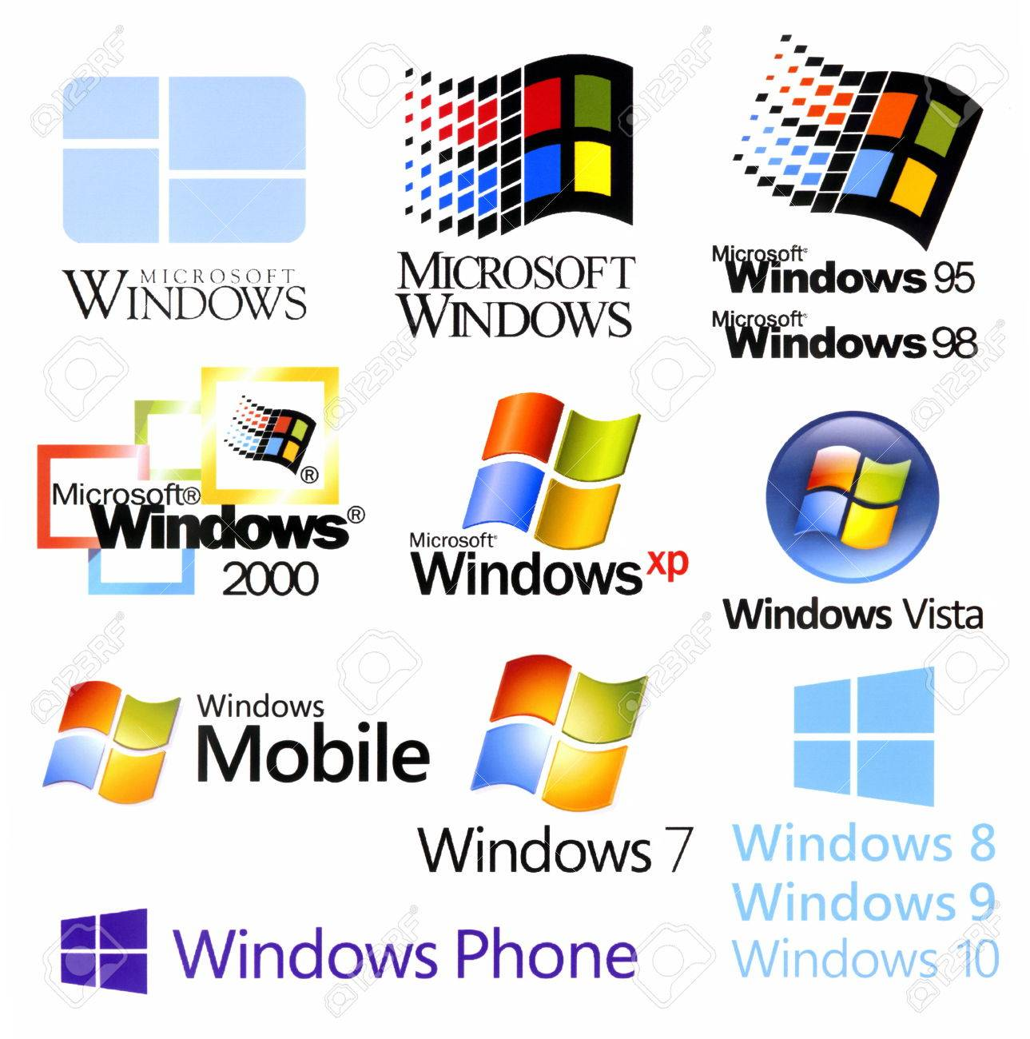

Slide 22
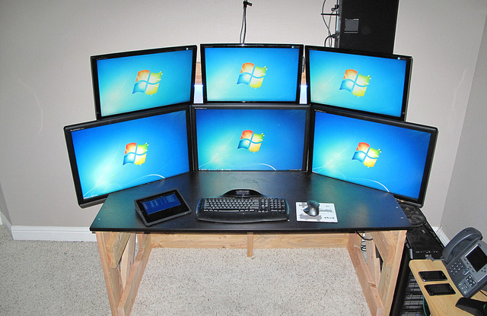
Workstation
A workstation (WS) is a computer dedicated to a user or group of users engaged in business or professional work.
It includes one or more high resolution displays and a faster processor than a personal computer (PC).
A workstation also has greater multitasking capability because of additional random access memory (RAM), drives and drive capacity.

Slide 23
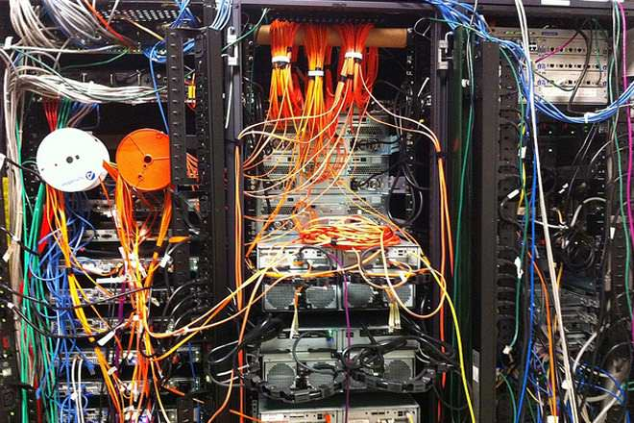
Windows Server
A server is an application or device that performs service for connected clients as part of client server architecture.
It can also be a computer system that has been designated for running a specific server application .
A server can also serve applications to users on an intranet

Slide 24
Kernel:
It is the core component of the operating system.
It acts as a intermediate between system hardware and application software.
Types of Kernel:
Monolithic kernel:
OS completely runs on kernel mode.
Runs entirely in a single address space.
Micro kernel:
OS completely runs on user mode.
kernel is divided into separate process and run in different address space.

Slide 25
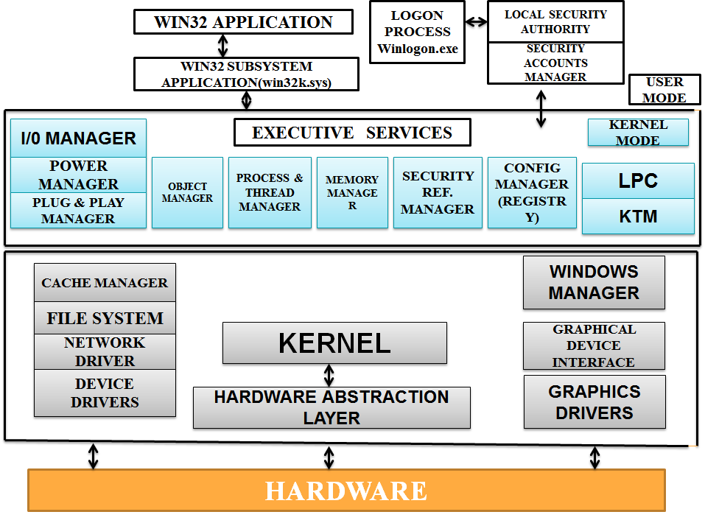
Kernel Architecture

Slide 26
Hardware Abstraction layer:
A hardware abstraction layer (HAL) is a logical division of code that serves as an abstraction layer between a computer's physical hardware and its software.
It provides a device driver interface allowing a program to communicate with the hardware.
Executive services:
Windows uses the term called executive services which refers to kernel mode components listed below:
1. Memory manager
2. Process manager
3. Object manager
4. Security Reference monitor
5. Configuration manager

Slide 27
Memory Manager: manages virtual memory, allowing Windows 2000 to use the hard disk as a primary storage device (although strictly speaking it is secondary storage). It controls the paging of memory in and out of physical memory to disk storage.
Process Manager: handles process and thread creation and termination
I/O Manager: allows devices to communicate with user-mode subsystems. It accepts file system I/O requests and translates them into device specific calls, and can incorporate low-level device drivers that directly manipulate hardware to either read input or write output.
It also includes a cache manager to improve disk performance by caching read requests and write to the disk in the background
Security Reference Monitor (SRM): the primary authority for enforcing the security rules of the security integral subsystem . It determines whether an object or resource can be accessed, via the use of access control lists (ACLs), which are themselves made up of access control entries (ACEs). ACEs contain a security identifier (SID) and a list of operations that the ACE gives a select group of trustees — a user account, group account, or logon session — permission (allow, deny, or audit) to that resource.

Slide 28
PnP Manager: handles Plug and Play and supports device detection and installation at boot time. It also has the responsibility to stop and start devices on demand — sometimes this happens when a bus gains a new device and needs to have a device driver loaded to support that device. Both FireWire and USB are hot-swappable and require the services of the PnP Manager to load, stop and start devices. The PnP manager interfaces with the HAL, the rest of the executive (as necessary) and with device drivers.
Power Manager: the power manager deals with power events and generates power IRPs. It coordinates these power events when several devices send a request to be turned off it determines the best way of doing this.
The display system has been moved from user mode into the kernel mode as a device driver contained in the file Win32k.sys.

Slide 29
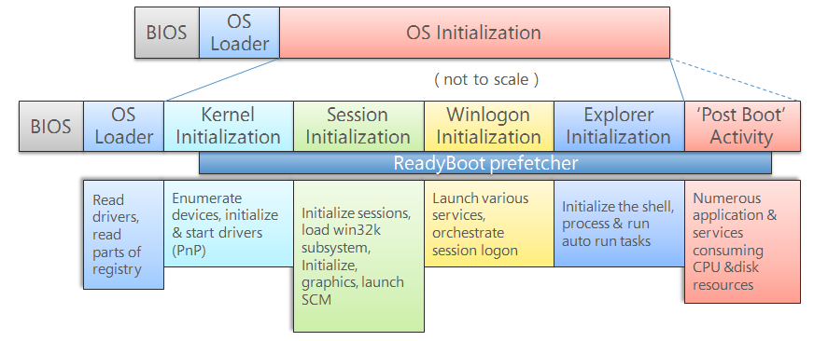
Windows Booting Process

Slide 30
Ntoskrnl.exe
Phase 0
Winlogon.exe
SMPS
Ntoskrnl.exe
Phase 1
logonUI.exe
BIOS (POST)
MBR
Smss.exe
dwm.exe
Csrss.exe
Bootmgr
Userinit.exe
Winresume.exe
Wininit.exe
Winload.exe
Explorer.exe
Services.exe
Lsass.exe

Slide 31
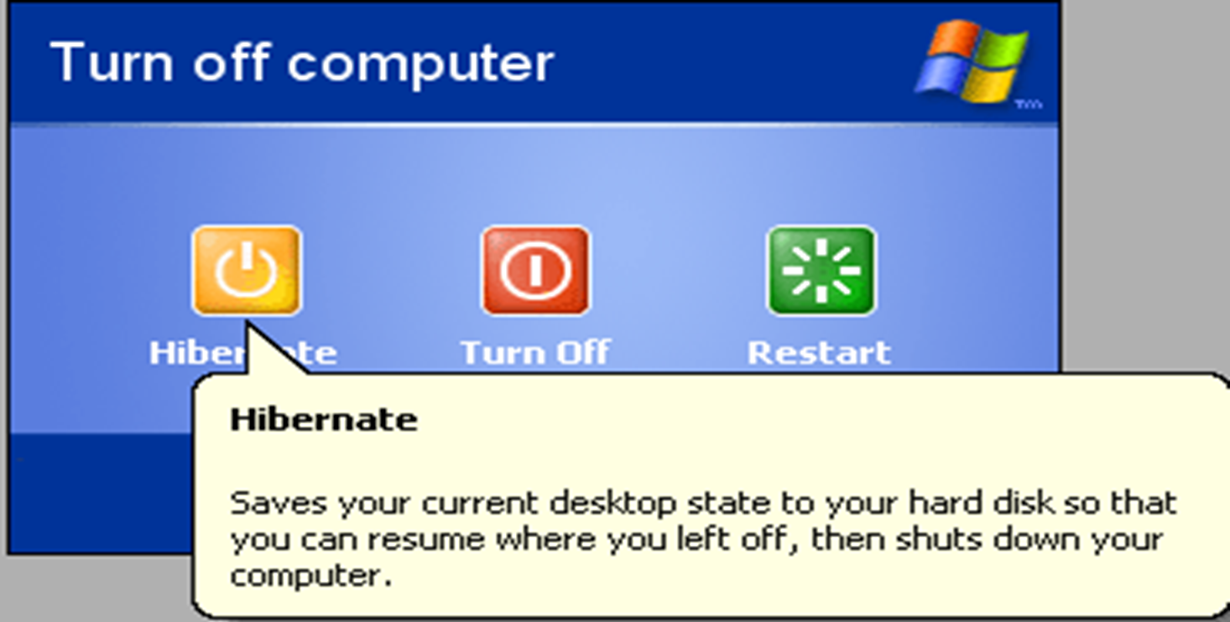
Hibernation

Slide 32

File System:
In computers, a file system is used to control how data is stored and retrieved.
The structure and logic used to manage the groups of information is called a “File system".
File Attributes:
Attribute | Bit Value
Read-Only (R) | 00000001
Hidden (H) | 00000010
System (S) | 00000100
Directory (D) | 00010000
Archive (A) | 00100000
Not Content Indexed (I) | 10000000000000
File attributes are pieces of information associated with every file and directory that includes additional data about the file itself or its contents.
In general file attributes are the characteristics of a file.

Slide 33
Types of File Systems
Windows File System
Disk File System
Optical Disks
Flash File System
Tape File System
Database File System
Network File System
Shared disk File System
Special File System
FAT
NTFS

Slide 34
FAT (File Allocation Table)
A file allocation table (FAT) is a table that an operating system maintains on a hard disk that provides the basic units of logical storage on a hard disk that a file has been stored in.
FAT was designed for small disks and simple folder structures.
FAT file systems are commonly found on floppy disks, flash and other solid-state memory cards.
Versions of FAT
FAT12
Supports drive sizes up to 16 MB using 4 KB clusters or 32 MB using 8 KB
Character limit of 8 characters, plus 3 for the extension.
FAT16
FAT16 drive can be ranges from 2 GB up to 16 GB.
File names were limited to 8+3 characters but was extended to 255 characters starting with Windows 95.
FAT32
FAT32 supports basic drive sizes up to 2 TB or even as high as 16 TB with 64 KB clusters.
Up to 268,173,300 files can be contained on a FAT32 volume so long as it's using 32 KB clusters.

Slide 35
Advantages :
Efficient use of disk space.
FAT can place the parts of the file wherever they fit.
File names can be up to 255 characters and file extensions longer than 3 characters.
Easy to recover file names that have been deleted.
Disadvantages:
Overall performance slows down as more files are stored on the drive.
Drives can become fragmented quite easily.
FAT lacks many of the security features in NTFS such as being able to assign access rights to files and directories.
It can also have file integrity problems such as lost clusters, invalid files and directories and allocation errors.

Slide 36
NTFS:
NTFS is a file system first introduced by Microsoft in 1993 with the release of Windows NT 3.1.
NTFS (New Technology File System) is the file system that the Windows NT operating system uses for storing and retrieving files on a hard disk.
Features:
Versions:
Support for very large files (up to 16 billion Bytes)
Integrated file compression.
Support for long file names as well as "8 by 3" names.
Data security on both removable and fixed disks.
An access control list (ACL) that lets a server administrator control who can access specific files.
v1.0 with NT 3.1 released in 1993.
v1.1 with NT 3.5 released in1994.
v1.2 with NT 3.51 released in 1995 and NT 4 (mid-1996) (occasionally referred to as "NTFS 4.0", because OS version is 4.0)
v3.0 from Windows 2000 (NTFS V5.0)
v3.1 from Windows XP, Windows Server 2003, Windows Server 2008,Windows7.

Slide 37
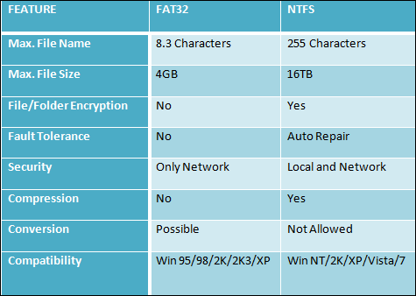
Comparison between NTFS & FAT

Slide 38
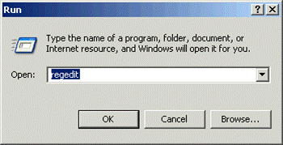
Windows Registry
The registry or Windows registry contains information, settings, options, and other values for programs and hardware installed on all versions of Microsoft Windows operating systems

Slide 39
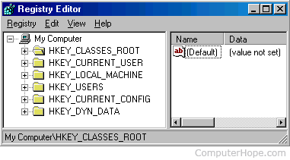
Structure of Registry
The registry contains two basic elements: keys and values.
Keys may contain values and subkeys.
A hive is a logical group of keys, subkeys, and values in the registry.
Editing:
A careless change to the operating system configuration in the registry could cause irreversible damage, so it is usually only installer programs which perform changes to the registry database during installation/configuration and removal.
Windows Registry can be edited manually using programs such as RegEdit.exe

Slide 40
Backup and Recovery:
System Restore can back up the registry and restore it as long as Windows is bootable, or from Windows recovery management .
NTBackup can back up the registry as part of the System State and restore it. Automated System Recovery in Windows XP can also restore the registry.
Windows NT 4.0 included RDISK.EXE, a utility to back up and restore the entire registry.
Windows 2000 Resource Kit contained an unsupported pair of utilities called Regback.exe and RegRest.exe for backup and recovery of the registry.
File locations
The location for system registry files in Windows NT is %SystemRoot%\System32\Config.
In Windows 9x the registry files are stored in the %WINDIR% directory under the names USER.DAT and SYSTEM.DAT with the addition of CLASSES.DAT .

Slide 41
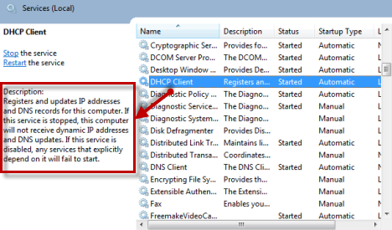
Services:
A Windows service is a computer program that operates in the background.
The Service Control Mechanism maintains database of the installed services and driver services that allow the Operating System to start successfully and provides a unified and secure means of controlling them.
Services.msc responsible for locate the services running on a computer .
It is responsible for each and every program or application which we use on a computer.

Slide 42
Service control manager:
starts, stops and interacts with Windows service processes.
Location-%SystemRoot%\System32\services.exe
Service processes interact with SCM through a well-defined API, and the same API is used internally by the interactive Windows service management tools such as the MMCsnap-in Services.msc and the command-line Service Control utility sc.exe.
Terminating this file is used as a method of causing the Blue Screen of Death.

Slide 43
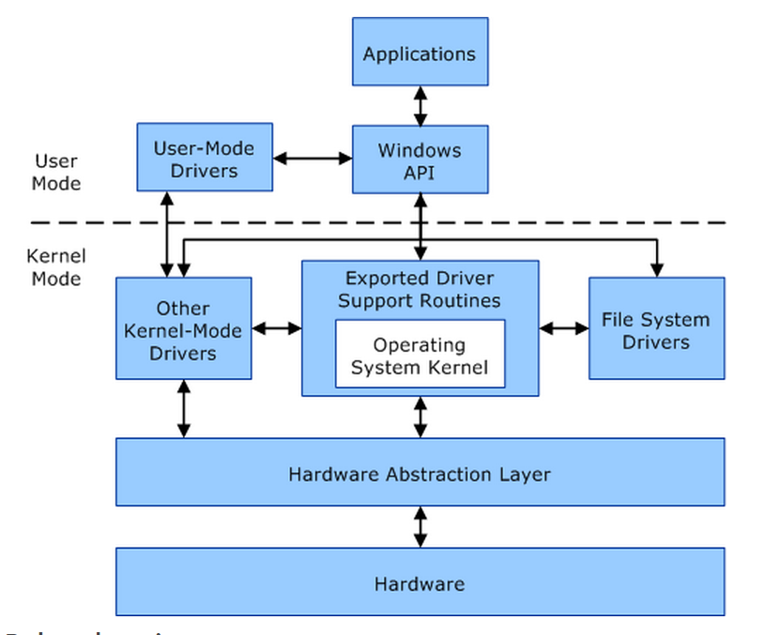
Device Management
Device Manager is a Control Panel applet in Microsoft Windows operating systems. It allows users to view and control the hardware attached to the computer. When a piece of hardware is not working, the offending hardware is highlighted for the user to deal with. The list of hardware can be sorted by various criteria.
For each device, users can:
Supply device drivers
Enable or disable devices
Tell Windows to ignore malfunctioning devices
View other technical properties

Slide 44
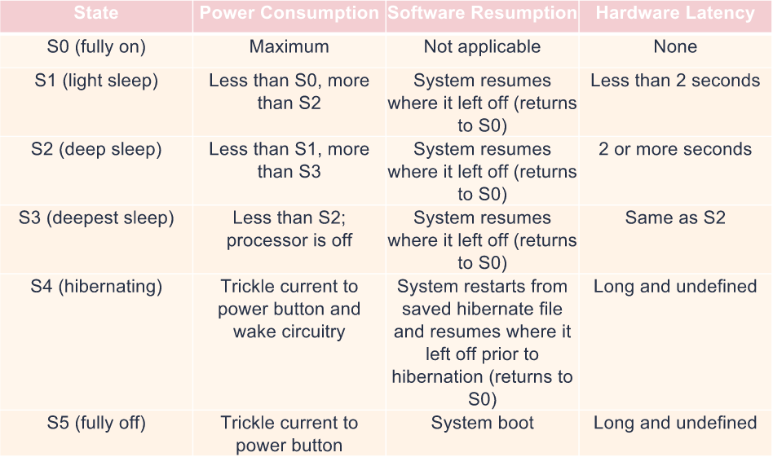
Power Management

Slide 45
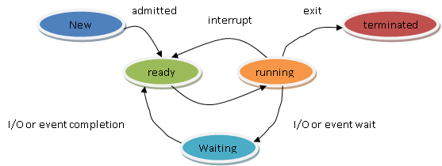
Process Management
A process is a software program that is currently running in windows.
A thread is an object that identifies which part of the program is running.
Process States :
New
Ready
Running
Waiting/blocked
Terminated

Slide 46
Memory Management
Virtual address space & Physical storage:
A binary number in virtual memory that enables a process to use a location in primary
storage independently of other processes and to use more space than actually exists in primary
storage by temporarily relegating some contents to a hard disk.
Working Set:
The working set of a process is the set of pages in the virtual address space of the process
that are currently resident in physical memory.
Page State:
Data Execution Prevention:
Virtual Address Space For 64 Bit Windows:
2^64 bytes (16 exabytes), but only a small portion of the 16-exabyte range is actually used.

Slide 47
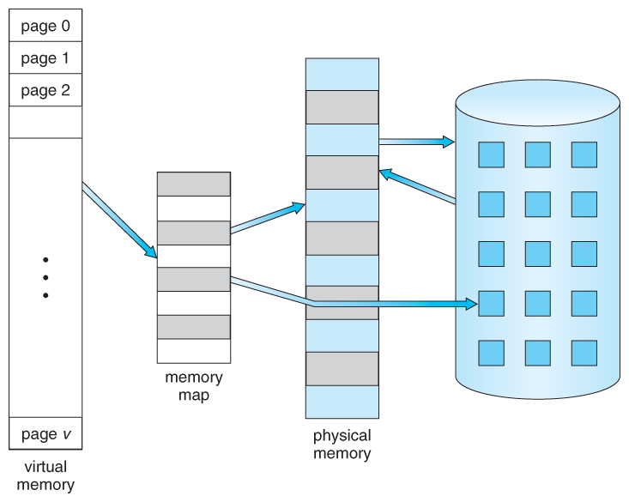
PAGING
Paging is a memory management scheme by which a computer stores and retrieves data from secondary storage for use in main memory.
In this scheme, the operating system retrieves data from secondary storage in same-size blocks called pages.
TYPES
Demand Paging
Memory Paging
Investigating Disk Paging
Anticipatory Paging

Slide 48
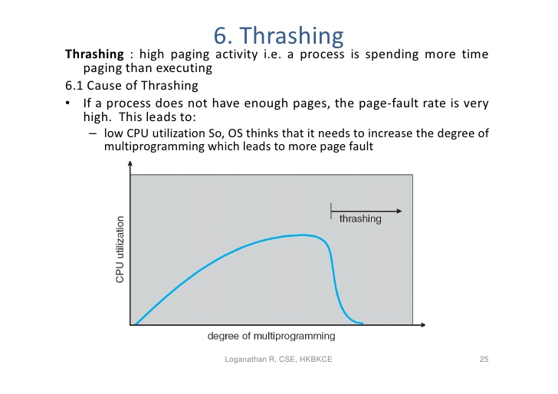
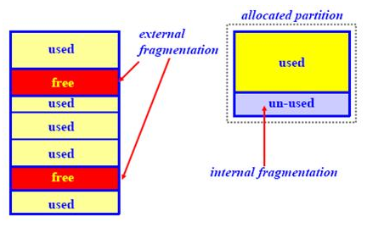
THRASHING
A high paging activity is called thrashing. This means a process is spending more time paging than executing(i.e., low CPU utilization).
Cause of Thrashing
If a process does not have enough pages, the page-fault rate is very high. This leads to low CPU utilization, OS thinks that it needs to increase the degree of multiprogramming which leads to more page fault.
FRAGMENTAION
External fragmentation arises when free memory is separated into small blocks and is interspersed by allocated memory.
Internal fragmentation is the wasted space within each allocated block because of rounding up from the actual requested allocation to the allocation granularity.

Slide 49
MEMORYPOOL
A more efficient solution is preallocating a number of memory blocks with the same size called the memory pool.
The application can allocate, access, and free blocks represented by handles at run time.
Many real-time operating systems use memory pools, such as the Transaction Processing Facility.
Types of memory pool:
The nonpaged pool consists of virtual memory addresses that are guaranteed to reside in physical memory as long as the corresponding kernel objects are allocated.
The paged pool consists of virtual memory that can be paged in and out of the system.

Slide 50
Virtual Memory
A computer can address more memory than the amount physically installed on the system. This extra memory is actually called virtual memory and it is a section of a hard disk that's set up to emulate the computer's RAM.
In computing, virtual memory (also virtual storage) is a memory management technique that provides an "idealized abstraction of the storage resources that are actually available on a given machine which "creates the illusion to users of a very large (main) memory.
Virtual memory Can be implemented using :
Demand Paging
Segmentation

Slide 51
FUNDAMENTALS
OF
LINUX

Slide 52
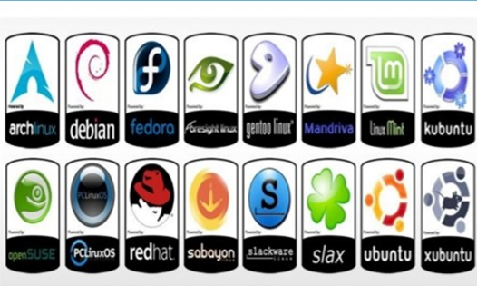
Linux OS
Linux is a name that broadly denotes a family of free and open source software OS built around the Linux kernel.
Linus Torwalds invented Linux in 1991 as a personal project.

Slide 53




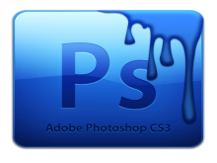



Software Licensing
Freeware
Shareware
Free with Limited Features
Free for limited time
Commercial
Open Source
Full / Partial features on cost
Free / Cost with source code

Slide 54
GNU Project
The GNU Project is a free-software, first announced on September 27, 1983 by Richard Stallman at MIT.
UNIX like Operating System that includes kernel, compiler, editor, graphical interfaces, etc.
GNU/Linux System
GNU General Public License

Slide 55
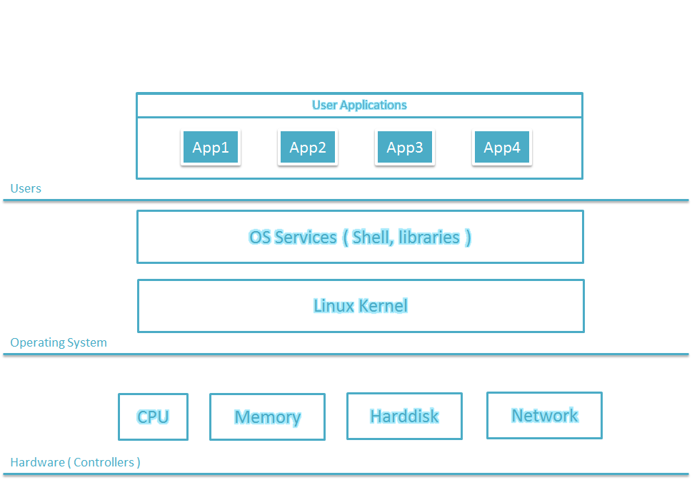
Linux Subsystem

Slide 56
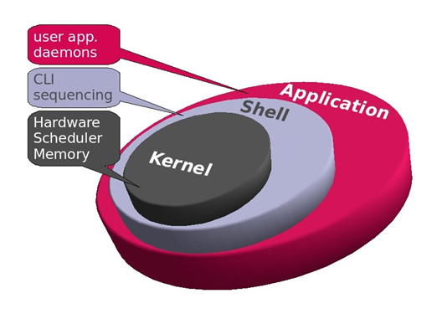
Linux Kernel
It is a bridge between application and the hardware.

Slide 57
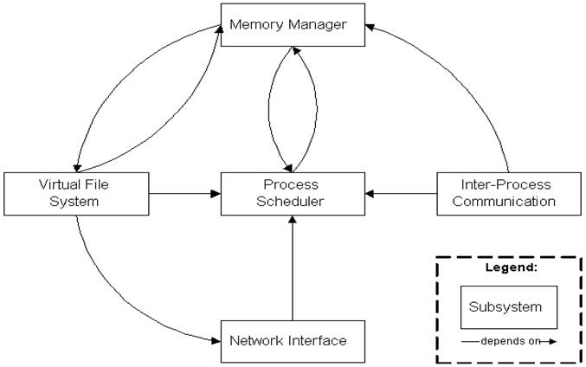
Kernel

Slide 58
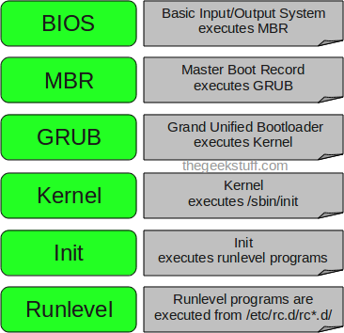
Linux Booting Process
Notes:
A cor AZUL sempre tem que aparecer no slide. Seja nas formas ou no texto.
Uma imagem como essa nao funciona. Muito “Barbie” para uma consultoria. Eles gostam deste layout mas deveria estar separador de capitulos com o logo de “espadas” maior. Para toda insercao de imagem o fundo deve ser cinza claro.

Slide 59
Linux Booting Process (Cont...)
LOAD STAGE 1.5 ,then STAGE 2 of GRUB
POWER ON
BIOS
LOAD STAGE 1 GRUB from MBR
KERNEL mounts ROOT FILE SYSTEM
GRUB Loads KERNEL image, and initial RAM disk
Present BOOT TIME MENU
GRUB reads menu.lst
KERNEL runs INIT
INIT runs scripts to start user level services

Slide 60
Linux Shell
Shell:
Shell is a UNIX term for the interactive user interface with an operating system. The shell is the layer of programming that understands and executes the commands a user enters. In some systems, the shell is called a command interpreter.
Features of shell:
1.Wildcard substitution in file names
2.Command aliasing
3.Command history
4.File name substitution
5.Input and output redirection
6.Piping
7.Shell variable substitution

Slide 61
Types of Shells
Bourne shell
C shell
TC shell
Z shell
Korn shell
Bourne-Again shell (BASH)
Bash:
The Bourne-Again shell is an updated version of the original Bourne shell that was created by the Free Software Foundation for its open source GNU project.
It is a widely used shell in the open source community.
It incorporates some of the more advanced features found in the C, TC and Korn shells.
Probably most advisable for beginning users while being at the same time a powerful tool for the advanced and professional use

Slide 62
Environmental variables:
Linux environment variables act as placeholders for information stored within the system that passes data to programs launched in shells or subshells.
Commands for Environment Variables:
env – The command lists all of the environment variables in the shell.
printenv – The command prints all of environment variables and definitions of the current environment.
set – The command assigns or defines an environment variable.
unset – The command deletes the environment variable.
export – The command exports the value of the newly assigned environment variable.

Slide 63
Run Levels
Run levels define what processes or services to run automatically while the system boots up.
This is defined in /etc/inittab file.
“init” process checks which default run level is defined in /etc/inittab and starts the system in that run level which means all the services defined for that run level gets executed.
There are 7 different run levels present (run level 0-6) in Linux system for different purpose. The descriptions are given below.
0: Halt System (To shutdown the system) 1: Single user mode 2: Basic multi user mode without NFS 3: Full multi user mode (text based) 4: unused 5: Multi user mode with Graphical User Interface 6: Reboot System

Slide 64
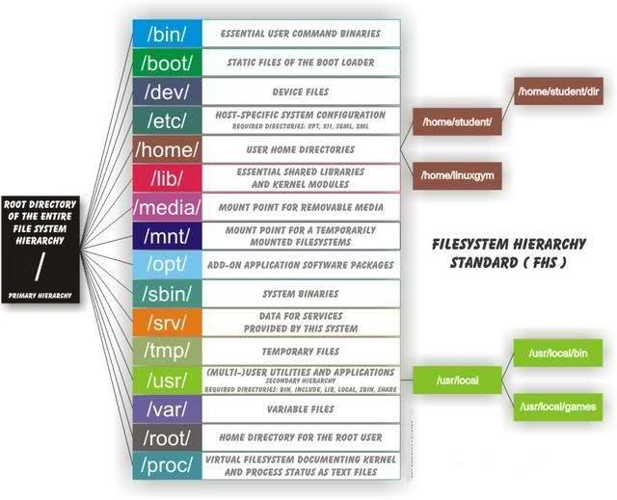
File Management

Slide 65
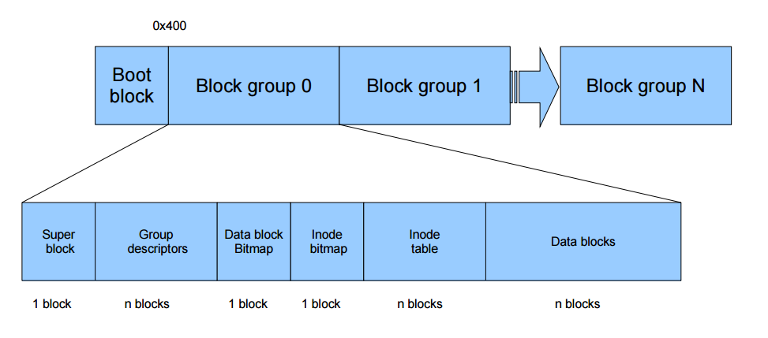
Structure of EXT4 File System

Slide 66
Device Management
Device Files :
A device file is an interface for a device driver that appears in a file system as it were an ordinary file.
Allows software to interact with the device driver using standard I/O system calls which simplifies many tasks.
Device files allows transparent communication between user space applications and computer hardware.
Interrupt Management
IRQ(Interrupt Service Request):
Hardware lines over which devices can send interrupt signals to microprocessor.
Assign different IRQ address to different hardware devices because the interrupt signals run along single IRQ lines.

Slide 67
In Linux all devices were considered as files
File | Device
/dev/fd0 | Floppy disk
/dev/hda0 | IDE Hard drive 1, partition 0
/dev/hdb3 | IDE Hard drive 2, partition 3
/dev/sda | First SCSI hard drive
/dev/cdrom | CD ROM drive This device may be on the secondary controller as a master (/dev/hdc) or slave (/dev/hdd).
/dev/mouse | May be a pointer to /dev/psaux which is the ps2 device or /dev/cua which is a serial device or /dev/ttyS0
Disk Drives
/dev/hda | primary IDE master
/dev/hdb | primary IDE slave
/dev/hdc | secondary IDE master
/dev/hdd | secondary IDE slave

Slide 68
PROCESS MANAGEMENT
Scheduling:
Key to multiprogramming is scheduling.
Different CPU scheduling algorithm have different properties.
Functions of scheduling:
CPU utilization
THROUGHPUT
TURNAROUND TIME
WAITING TIME
RESPONSE TIME
FAIRNESS

Slide 69
TYPES OF SCHEDULING:
NORMAL
FIFO
Round Robin
Priority based scheduling
TYPES OF PROCESSES:
Interactive process
Batch process
KILL process
ZOMBIE process
Redirection process

Slide 70
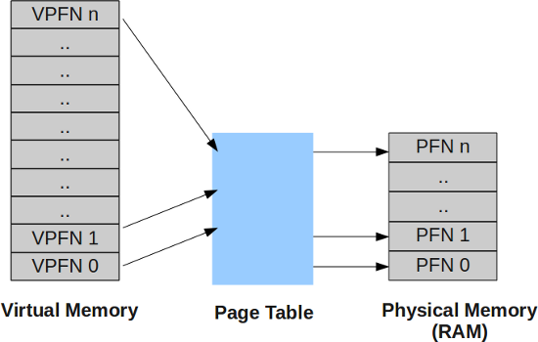
Memory Management
VIRTUAL MEMORY:
Method of providing the full address space by using a combination of RAM and hard disk is called as virtual memory.
Virtual - Appearing to exist but not really through.

Slide 71
MEMORY MAPPING:
Used to map image and data files into a process address space.
The contents of a file are linked directly into the virtual address space of a process.
DEMAND PAGING:
OS should not use physical memory inefficiently.
Technique of loading virtual pages into memory as they are accessed is known as demand paging.
Eg: Db query engine.

Slide 72

Algorithms

Slide 73

MEMORY MAPPING:
Swapping:

Slide 74
Page allocation:
Buddy algorithm
Pages are allocated in blocks which are powers of 2 in size.
Page deallocation:
Recombines pages into larger blocks of free pages whenever it can.

Slide 75
Thank You!

